Slide 1
US Accidents – Modelling and Prediction
Knowledge Based Systems
Team Members
Aditya Kamble
Sidharth Panda

Slide 2
Dataset - US Accidents (3 Million Records)
A Countrywide Traffic Accident Dataset (2016 - 2019)
This is a countrywide traffic accident dataset, which covers 49 states of the United States. The data is collected from February 2016 to December 2019, using several data providers, including two APIs which provide streaming traffic event data. These APIs broadcast traffic events captured by a variety of entities, such as the US and state departments of transportation, law enforcement agencies, traffic cameras, and traffic sensors within the road-networks. Currently, there are about 3.0 million accident records in this dataset.
Since the dataset contains 3.0 million records, It’s difficult for a user to bring out the useful insights.
Specific questions like the Total number of accidents per city or state can be calculated using statistics, but more details related to the individual factors affecting the result can be sought by visualization. Having a multiple columns helps in finding the relation between several factors responsible for the accidents can be explored and explained through visualization.

Slide 3
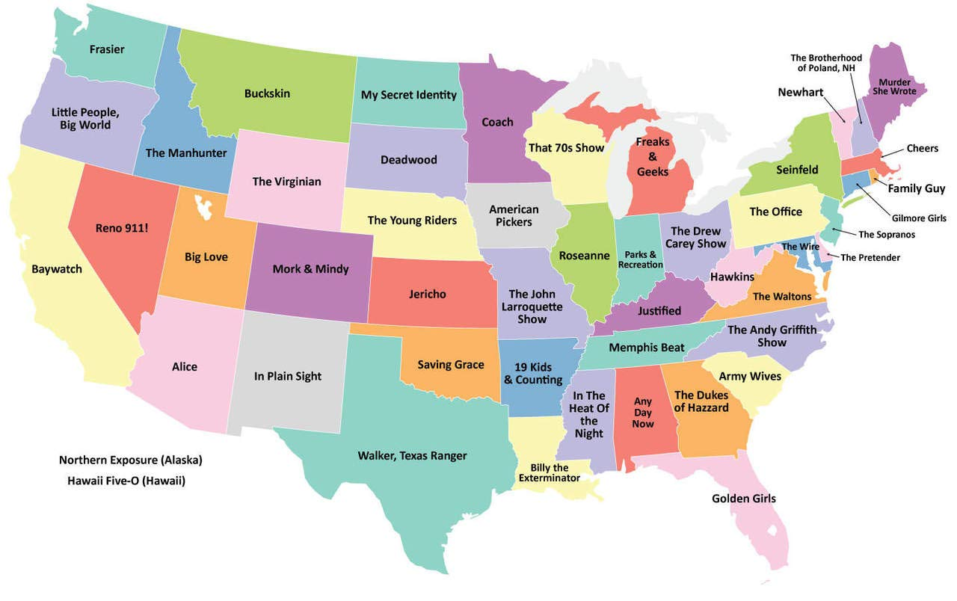
What is the number of accidents of a state as compared to its adjacent states?
Yes, through statistics we can get information for the number of accidents in each states of the country. But, a person outside of US cannot possibly know if a state is adjacent to another. For that we will require a simple map visualization of US.
Image source:
https://images.app.goo.gl/5cwJ7Qrps7dczn85A

Slide 4
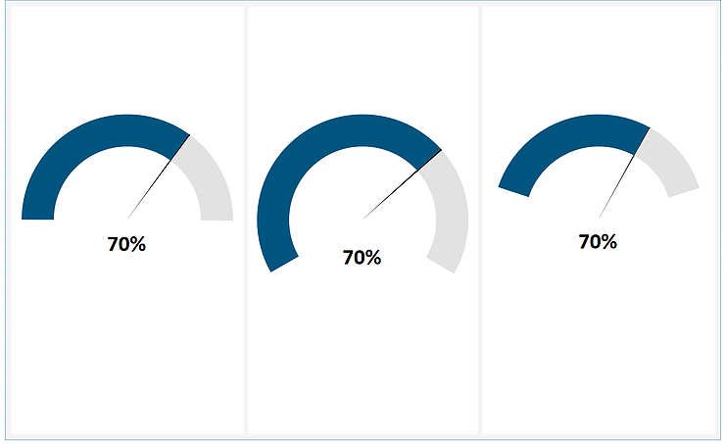
Why and how wind speed and wind direction contribute to accidents?
We can use Map visualization or Dual-Axis Chart or Gauge chart to visualize the the impact of wind speed/direction on the accidents.
Image source :
https://www.storiesondata.com/post/gauge-charts-speedometer-in-tableau-without-custom-data

Slide 5
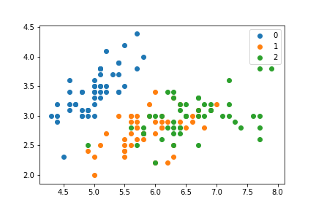
How does Weather condition and time affect visibility which results in the number of accidents?
Here we are considering 3 factors which are most relevant to accidents. Using simple statistics will be difficult to understand combined impact of these factors. So we can use Multidimensional Visualization

Slide 6
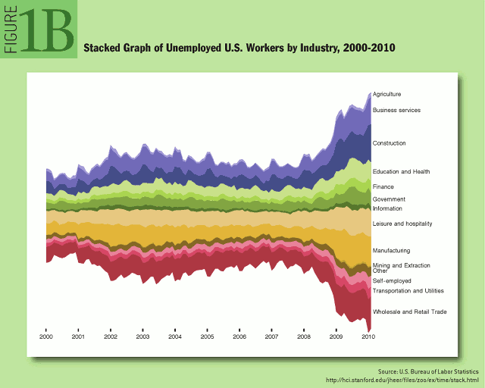
Do accidents happen due to stop signs w.r.t time of the day?
For better understanding we can use the time series visualization to display the time at which people cross the stop sign. For example, is it during office hours, during weekend, on a friday night.

Slide 7
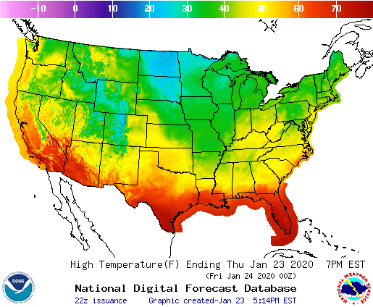
Is the accident rates in different states higher due to different Weather Condition?
We can take in to account the heatmap visualization to display the number of accidents happening due to the weather condition.

Slide 8
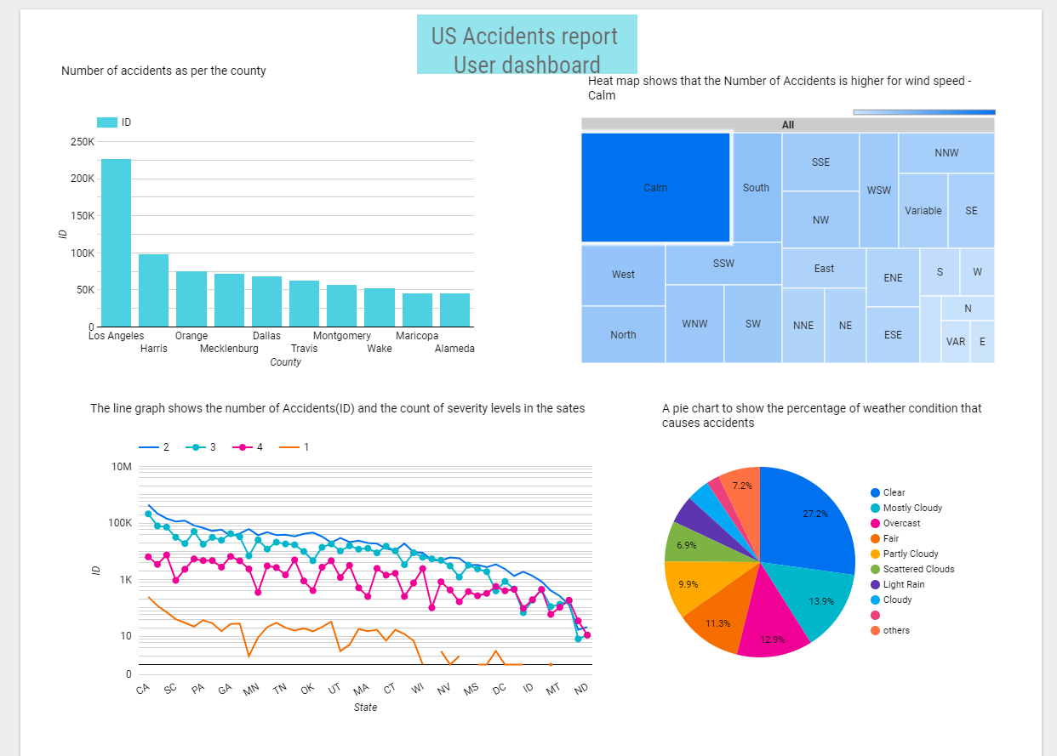
User and Engineer Dashboard using Data Studio

Slide 9
EDA and Data Preparation
https://nbviewer.jupyter.org/github/kbs-group-9/kbs-group-9.github.io/blob/master/notebooks/US%20Accidents%20-%20EDA.ipynb#Import-Dependencies
GitHub Link
https://github.com/kbs-group-9/kbs-group-9.github.io/tree/master/notebooks

Slide 10
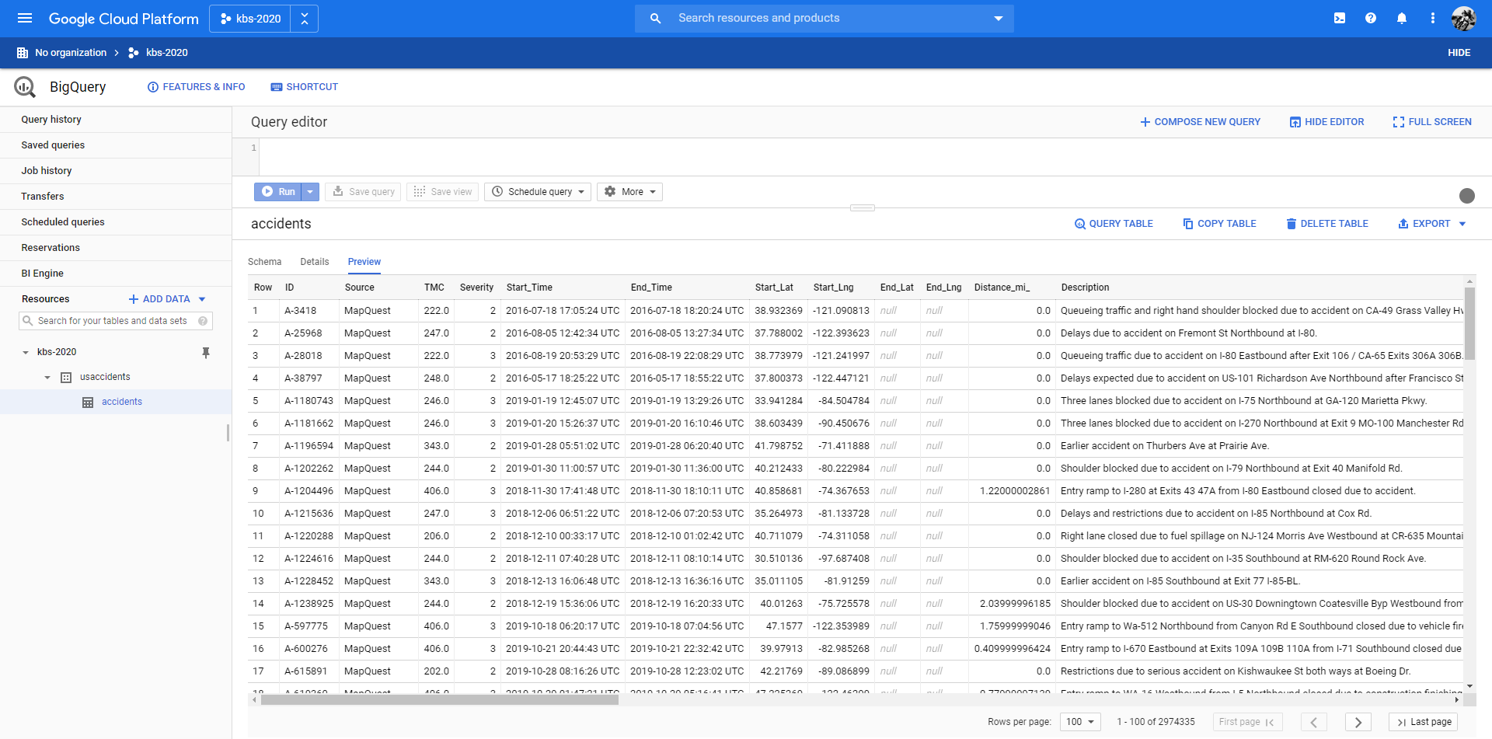
Using BigQuery to create table and execute sql queries

Slide 11
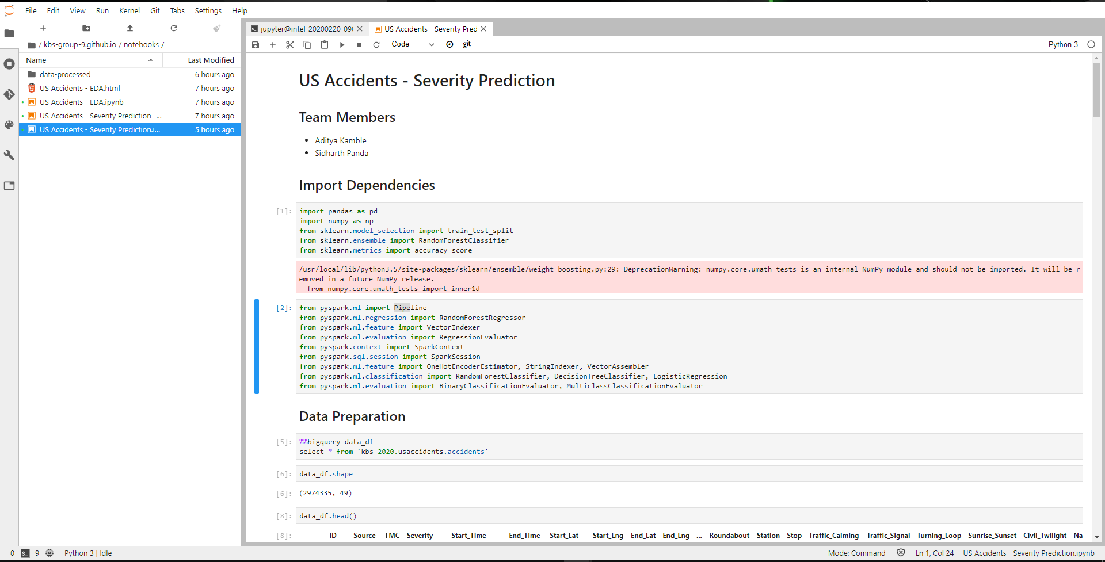
Using BiQuery API in AI Notebook to perform EDA and ML Modeling using PySpark

Slide 12
References
Data Set - https://www.kaggle.com/sobhanmoosavi/us-accidents

Slide 13
Thank You

